Slide 1
ACJA/ACJLs: Towards National Minimum Standards of Implementation
By
Professor Yemi Akinseye-George, SAN, FCIArb. (Nig.)
Centre for Socio-Legal Studies (CSLS)

Slide 2
4 most critical elements of ACJA
Section 106-ban on lay prosecution
Section 306-ban on stay of proceedings
Section 396-Speedy trial protocols
Section 469- Coordinating mechanism.
-Yvonne Darkwa-Poku, MacArthur Foundation

Slide 3
Other critical elements
Human Rights compliance- pre-trial rights; protection of vulnerable persons including indigent defendants, victims, women and children;
Accountability provisions-Timelines, inspections and reporting requirements;
Mandatory collection and preservation and access to data and statistics;
Technology-aided justice administration;
Restorative justice mechanisms; and
Relevance to local needs.

Slide 4
Pre-trial: Minimum requirements
Arrest Protocols-Level of awareness by investigators of the pretrial rights of suspects.
Compliance by investigators with arrest protocols.
Availability of guidelines or checklists to promote compliance with arrest protocols-
Training opportunities to increase awareness and compliance by investigators with arrest protocols;

Slide 5
Pre-trial: Minimum requirements (contd.)
Leadership and support provided the police by the Judiciary or MOJ to improve compliance with arrest protocols, e.g. provision of copies of the ACJL and related materials for the police.
Recording confessions electronically or in the presence of witnesses;
Opportunities or platform for indigent persons to obtain remedies for grievances in respect of violations of arrest protocols.

Slide 6
Investigators/Prosecutors synergy
This includes early engagement by prosecutors and investigators to build solid case files; oversight of police investigation by prosecutors is a mark-up point.
Creative measures to promote synergy such as
platforms for periodic official and social interactions between Investigators and Prosecutors-liaisons, get-togethers, sports competitions; networking, joint training, investigation-teams, etc

Slide 7
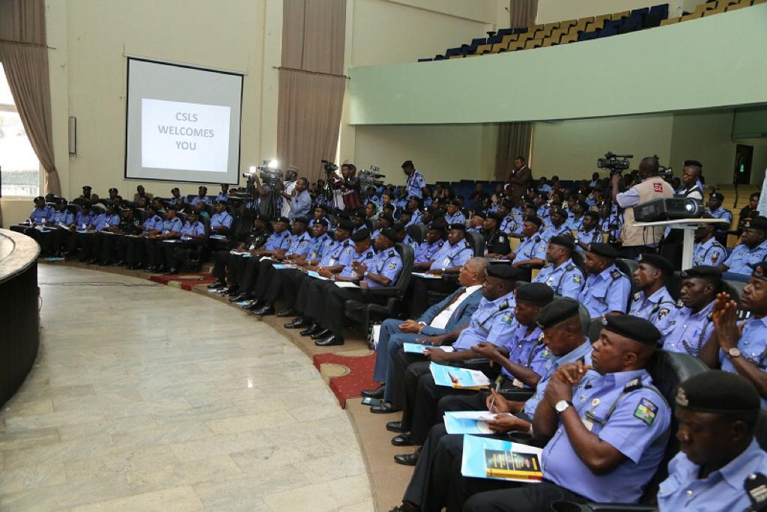

Slide 8
Bail- actualization of liberal policy
Administrative bail;
Court bails;
Accurate record of the exercise of bails powers-
Rate of abscondment of suspects on bail-
Verification of sureties.
Prohibition of fake or professional sureties.
Creation and use of Professional bondsmen is a mark-up point;

Slide 9
Remand Proceedings
Express Prohibition of use of ‘holding charges’ (mark-up);
Compliance with remand protocols.
Features:
Permissible intervals of remand: 14 to 30 days;
Compliance by Magistrates with remand timelines- automatic review mechanism;
Record of discharges upon expiration of specified time limits;
Existence of checks and balances for remittance of case files by investigators to AGs for Legal Advice and prosecution e.g. Making the forwarding of case file to the AG for legal advice a condition precedent to grant of application for remand.

Slide 10
Inter-agency cooperation in respect of remand proceedings
Support provided the police in terms of equipment and stationery for prompt duplication of case files.
Measures for monitoring the use of remand powers;
Training opportunities for magistrates on remand protocols

Slide 11
Pre-Trial Legal Advice
Time frame for issuance of legal advice by the MoJ to the police;
Measures for ensuring compliance with time frame.
Transparency of the process of issuing legal advice.
Distribution of workload in the DPP office;

Slide 12
Expediting Trial
Service of charge or information;
Assignment of cases to courts-transparency in the process;
Arraignment of suspects;
Preparation for trial-measures to ensure speedy trial;

Slide 13
Trial or Plea bargaining
Template for Plea bargaining;
Plea bargaining checks and balances; e.g. approval by AG personally or review of PB decision by a technical committee in the MoJ;
measures to encourage use of plea bargaining.
Access to records of PB agreements.
Review of PB decisions;

Slide 14
Readiness for day-to-day Trial
Witness/victims support-
Witness payment-
witness protection;
Logistics for preparing trial-coordination between court and correctional service;
Temporary holding facilities in court premises; or
Temporary relocation of court to Prison premises or video link

Slide 15
Readiness for day-to-day Trial (contd.)
Compliance with adjournment limits;
Checklists to ensure day-to-day trial or effective case management;
Average time to complete trial in the lower courts;
Average time to conclude trial in the High Courts.

Slide 16
Measures to curb delay of trials:
Abolition of trial within trial by law or practice directions?
Interlocutory proceedings?
Stay of proceedings?
The problem of absconding defendants;
Attachment of property of absconding defendants;
Use of e-recording to expedite trials?
Grant of dispensation to elevated or transferred judges to conclude part-heard matters.

Slide 17
Measures to curb delay of trials (contd.)
Incentive package (expenses and logistics) for prosecutors-is it institutionalized or subject to the whims and caprices of the incumbent AG?
Oversight of the work of prosecutors.
Existence and ease of Feedback mechanisms from the courts.

Slide 18
Incentive regime-beyond salaries
Incentives for Magistrates;
Incentives for Judges-
Availability of court users' committees?
Training of magistrates and judges on effective case management;
pre-trial settlements of issues;
Disclosure protocols-Measures for improving bench bar relationship;
notice to the bar of changes in scheduled hearing dates;
Spread of workload;

Slide 19
Champion of the Justice system
Awareness of the concept of ‘The Chief Judge as the Champion of the criminal justice system’;
Measures to ensure qualitative administrative support for the Chief Judge by the Chief Registrar;
Availability of data on court performance;
Evidence-based advocacy for funding-

Slide 20
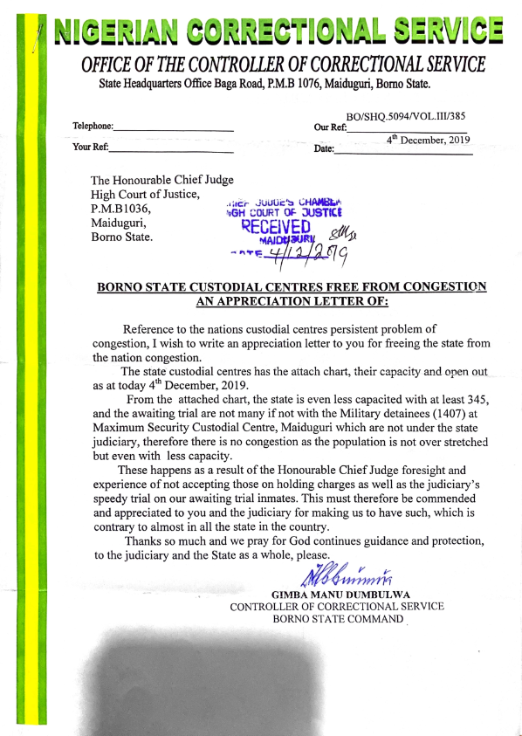

Slide 21
Budget & Infrastructural support
Quantum and quality of court Infrastructure; gadgets; ventilation, furniture; power supply;
Judiciary budget and actual releases in the last three years including the year of review;
Judiciary workload in the last three years including the year of review

Slide 22
Trial of Children in conflict with the law
Existence of family courts-
Capacity building of family courts-
Non-Detention of children in adult Correctional Centres is a mark-up point.

Slide 23
Complimentary practices
Issuance of practice Directions to address gaps in the law;
Clear guidelines on registry practices;
Existence of help desks in court registries.

Slide 24
Post trial
Separate Sentencing hearings;
Availability of record of previous convictions;
Sentencing guidelines;
Availability of alternatives to incarceration.
Training on the use of sentencing guidelines;
Training on the use of non-custodial measures.

Slide 25
Citizens Engagement
Measures to deepen public support for crime prevention by sensitizing the public on their roles and Civic duties as:
Complainants;
Witnesses;
Informants or whistle blowers
Justice of the peace;
Vigilantes; and
Providers of support for law enforcement generally.

Slide 26
Conclusion
The foregoing are the points that will guide the development of questionnaires and indicators for evaluating the performance of stakeholders including States and the FCT in the implementation of the Administration of Criminal Justice Act (ACJA) and ACJ Laws.
The First Technical Review Meeting of Stakeholders will take place in December 2020 to prepare for the first National Technical Evaluation (NTE) which will be in December 2021. The National ACJA Implementation Report Launch and Gala Night of Awards will be in early 2022, Deo Volente.

Slide 27

This Photo by Unknown Author is licensed under CC BY-NC

